Slide 1
CAPSTONE PROJECT-BATTLE OF NEIGHBOURHOOD
By-Arundhati Baksi

Slide 2
INTRODUCTION TO BUSINESS PROBLEM
Opening of a MNC Bank branch in one of the HNI residency location in Bangalore

Slide 3
BASIS OF THE PROBLEM
Bengaluru is the third wealthiest city in India according to a study. Bengaluru boasts of a total wealth of USD 320 billion. The city is a home to 7,500 millionaires and 8 billionaires.
HNI's in Bengaluru prefer to invest in various investment products, real estate, digital currency etc., which gives huge opportunities to financial institutions like banks.
Looking at the current situation most of these ultra HNI's will prefer to work from home. So opening bank branch in one of these residency area will provide bank more opportunities to onboard such customers and cross sell multiple banking products.

Slide 4
SOURCE OF DATA
We will be using Foursquare location data to get our required data for execution as we don't get any particular website which can give location data for only HNI residency in Bangalore.
Firstly, we will get the geographical coordinates for Bangalore using Foursquare location data and then use it to get neighbourhood information for various HNI's residency location in Bangalore.
With these data we will create our dataframe for analysis.

Slide 5
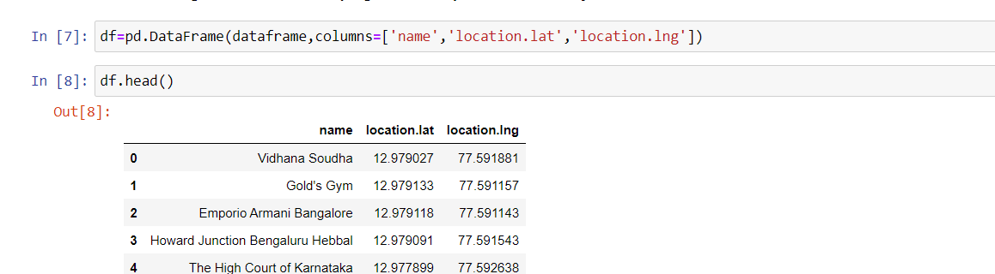
DATAFRAME

Slide 6
METHODOLOGY
We use K-Nearest Neighbour (KNN) classification algorithm to do our analysis.
Since the most preferred value of k is 5, so value of k for our analysis is also 5. We have clustered all our data points in 5 clusters.

Slide 7
ANALYSIS
As we have taken the value of K as 5 the entire dataset consisting of 51 locations is divided into 5 cluster i.e., Cluster1, Cluster2, Cluster3, Cluster4 and Cluster 5.

Slide 8
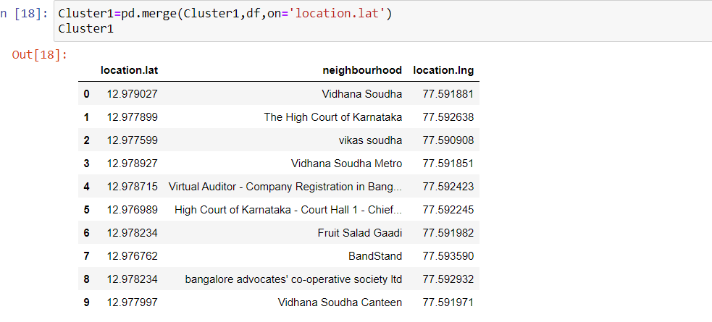
CLUSTER1 (10 locations)

Slide 9
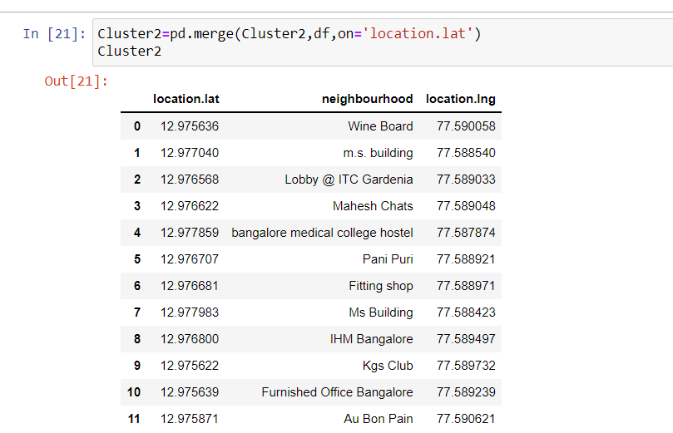
CLUSTER2 (12 locations)

Slide 10
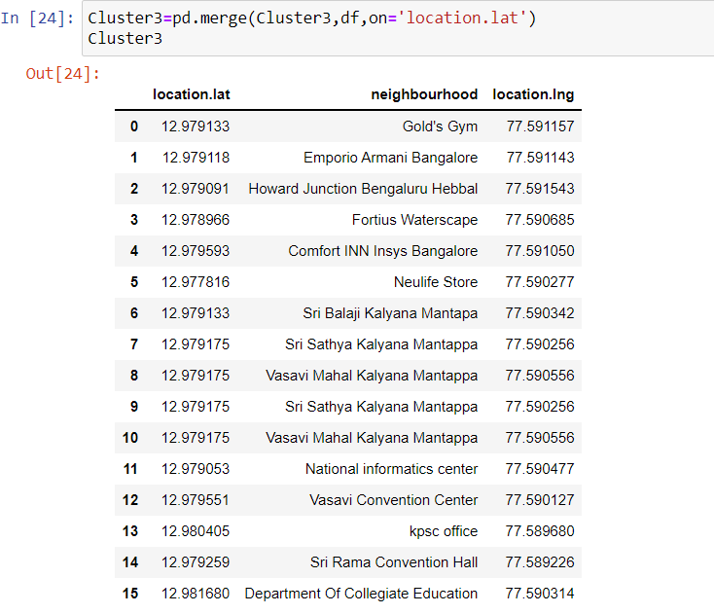
CLUSTER3 (14 locations)

Slide 11
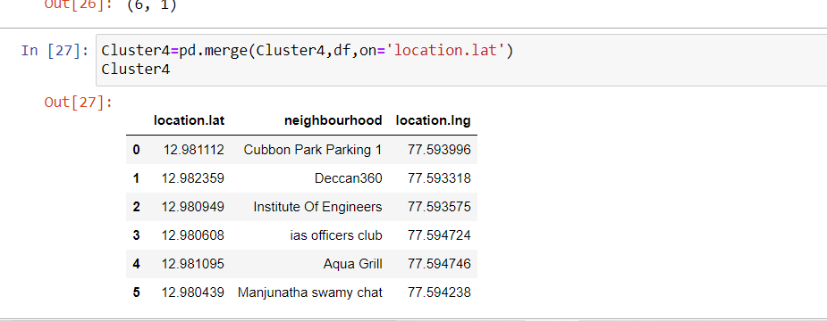
CLUSTER4 (6 locations)

Slide 12
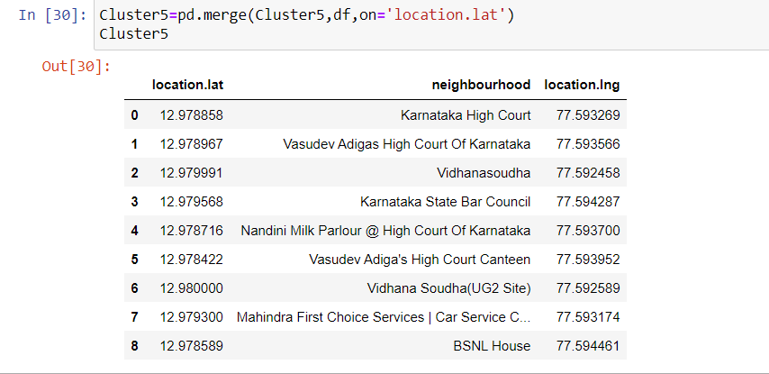
CLUSTER5 (9 locations)

Slide 13
DISTRIBUTION OF LOCATION

Slide 14
CONCLUSION
We select cluster3 as it covers the most no of locations.

Slide 15
THANK YOU

